Slide 1


OpenStreetMap on Android
Jürgen Broß and Thilo Mühlberg

Slide 2
Agenda
Quick introduction of the mapsforge project
OpenStreetMap on Android
Our approach to mobile map rendering
Our free map library for Android
Our free map application for Android
Hello, MapView
Mapsforge – besides map rendering
Questions and short live demo

Slide 3
About mapsforge
The mapsforge project
  initiated at the computer science institute
  of Freie Universität Berlin
  was started in 2008
  provides free mapping and navigation tools
  is based on OpenStreetMap and free software
  currently involves 15 students and scientific staff
  (and irregular external contribution)
  since April 2010 at Google Project Hosting
  since May 2011 uses the LGPL3 license for all source code (was GPL3)
http://mapsforge.org

Slide 4
What we do
Creating various tools for
  Map rendering and overlays
  Route planning and navigation
  Address lookup and geocoding
  Spatial data formats and algorithms
Focus is on mobile devices
  Currently only Android
  In the future also other platforms (iOS, PC)
We aim for maximum flexibility
  Configurable map extraction and rendering
  Configurable navigation and routing
  Online and offline services

Slide 5

OpenStreetMap on Android
The OpenStreetMap (OSM) project
  Creative Commons license (changing to ODbL)
  Map data can be downloaded as XML or PBF files
  Rendered tiles available as PNG files
Many applications for OSM on Android exist
  Not all of them are free software
  Only few can work completely offline
  Only very few render map images on the device
Advantages of rendering OpenStreetMap offline
  No internet connection required
  Saving money and privacy
  Much more flexible than static tiles

Slide 6
Our approach to mobile map rendering
All map data is stored on the device
  Preprocessing of OSM data with a converter
    Input: Raw OSM data (berlin.pbf ~ 16 MB)
    Output: Single binary file
    (Berlin: 11 MB, full details including names)
    No pre-rendering of images or tiles
  Finally the map file is copied to SD card
Tile based rendering
  Tile = small, rectangular part of a map
  De facto standard for online maps
  Advantages
    Incremental map rendering
    → better user experience
    Allows caching and pre-rendering
    → higher frame rate

Slide 7
Challenges of mobile map rendering
Rendering a map is difficult
  Get all map data that intersects with the area
  Correct handling of overlapping map objects
  Fast but accurate map projection
  Filter map objects by zoom level
  Collision free label placement
  Correct handling of coast lines
  …
Specific challenges of tile-based rendering
  Increased complexity due to dependencies between tiles
  Scheduling of all required tiles

Slide 8
Android specific challenges
Memory Management
  Limited amount of RAM per process
  Return value of Runtime.freeMemory() not reliable
  Be aware of memory leaks
Issues with Android activity lifecycle
  No single exit point (application may be killed by OS)
  Delayed execution of onStop() and onDestroy()
  → potential race conditions
  → potential OutOfMemoryException
  Handling of configuration change (e.g. orientation, language)
Multiple Android versions and devices
  Be aware of market fragmentation (regarding different versions)
  Different screen resolutions and densities
  Device-specific bugs
Notes:
Bild zu Android activity lifecycle in Browsertab offen
→ killable

Slide 9
Our free map library for Android
Library for rendering map tiles on different zoom levels
  Implements important classes and methods from the
  com.google.android.maps API
  High level of detail and rendering quality
  Intelligent caching of tiles in RAM and on SD card
  Integrated map scale and zoom controls
  Supports multi-touch and multi-tap gestures as well as animations
  Library comes as ~ 400 kb JAR file (including sources)
Key class is the MapView
  Handles user input via touchscreen (multi-touch), keys or trackball
  Assembles tiles into one big image on the screen
  Tiles are rendered asynchronously
  Additional support for downloading of map tiles

Slide 10
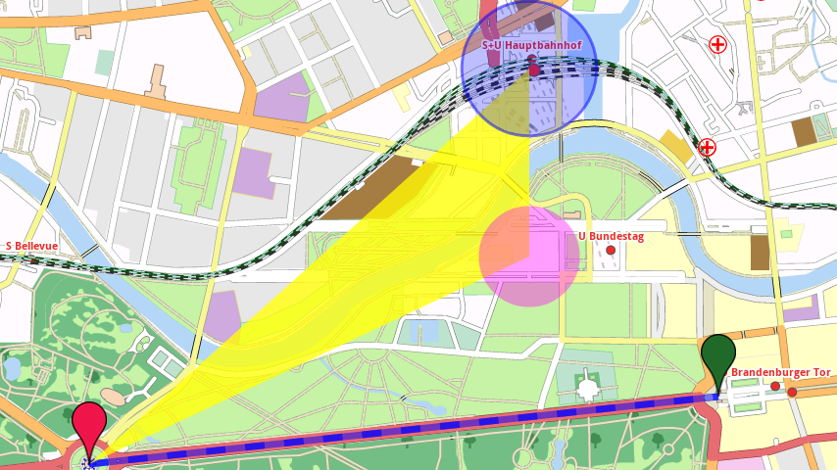
Our free map library for Android
Map overlay
  Implements important classes and methods from the
  com.google.android.maps API (Overlay, ItemizedOverlay, OverlayItem, ...)
  In addition: ways and (multi-)polygons
  High flexibility and performance
    Drawing parameters, e.g. color, line width, transparency
    Configurable event handling (tap, long press)
    Supports large amount of overlay items/ways/polygons/circles

Slide 11
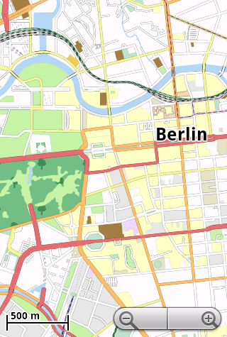
Our free map application for Android
Working title: AdvancedMapViewer
  Runs on all Android versions ≥ 1.5
  Uses our map library and MapView
  Serves as demo application and test case
Some features
  Show current location
  Select map file in a file browser
  Configuration via preferences
  Currently included languages:
  English, German, Italian, Finnish
Download the APK file from our website
Map files are provided at ftp.mapsforge.org

Slide 12
Hello, MapView (Google Version)
import android.os.Bundle;
import com.google.android.maps.MapActivity;
import com.google.android.maps.MapView;
public class HelloMapView extends MapActivity {
@Override
protected void onCreate(Bundle savedInstanceState) {
super.onCreate(savedInstanceState);
MapView mapView = new MapView(this, "Your Maps API Key");
mapView.setClickable(true);
mapView.setBuiltInZoomControls(true);
setContentView(mapView);
}
@Override
protected boolean isRouteDisplayed() {
return false;
}
}
AndroidManifest.xml:
<uses-permission android:name="android.permission.INTERNET" />

Slide 13
Hello, MapView (mapsforge Version)
import android.os.Bundle;
import com.google.android.maps.MapActivity org.mapsforge.android.maps.MapActivity;
import com.google.android.maps.MapView org.mapsforge.android.maps.MapView;
public class HelloMapView extends MapActivity {
@Override
protected void onCreate(Bundle savedInstanceState) {
super.onCreate(savedInstanceState);
MapView mapView = new MapView(this, "Your Maps API Key");
mapView.setClickable(true);
mapView.setBuiltInZoomControls(true);
mapView.setMapFile("/sdcard/berlin.map");
setContentView(mapView);
}
@Override
protected boolean isRouteDisplayed() {
return false;
}
}
AndroidManifest.xml:
<uses-permission android:name="android.permission.INTERNET" />
<uses-permission android:name="android.permission.WRITE_EXTERNAL_STORAGE" />
New!

Slide 14
What else (finished but not yet released)?
Address lookup, geocoding
  Challenges
    Many different address formats in OSM (also depending on country)
    Administrative boundaries (e.g. cities) incomplete
    Lack of housenumbers
  Frontend: structured interface backed by sqlite database
  Source code released as a separate project at sourceforge.net/projects/osm4j/
Navigation modules
  Fast server-based routing with turn-by-turn directions and landmarks
  (demo available at http://tom.mapsforge.org/)
  Fast onboard routing based on the Highway Hierarchies algorithm

Slide 15
What else (work in progress)?
Map rendering module
  Compression of map tile images [4 / 6]
  Rendering style API [2 / 6]
  Better label placement algorithms [1 / 6]
  Porting to iOS (Objective C) [0 / 6]
  Complete rewrite to use OpenGL rendering [0 / 6]
    Allows for 2.5D maps
    Requires adjustments to current map file format
Navigation modules
  Map matching, guidance [2 / 6]
  Better heuristics for edge weight computation, turn restrictions [1 / 6]
  Better onboard routing with the Contraction Hierarchies algorithm [0 / 6]
Applications
  OSM tracker “TraceBook” [3 / 6]
  Integrated download manager [2 / 6]

Slide 16
Thank you!
http://mapsforge.org

